Slide 1

A Short Tour of Machine Learning
Michael Mathioudakis
Covve, Athens, 2017-08-02

Slide 2
today
goal:
what is machine learning?
emphasis on principles – we’ll start slow
examples of ML tasks and algorithms
how you would formulate a ML task
how you would use a ML algorithm
not technical details about how to develop one
part 1: machine-learning algorithms
basic concepts and the ML pipeline
algorithms
part 2: platforms and software
part 3: hands-on session

Slide 3
part 1: machine learning algorithms

Slide 4
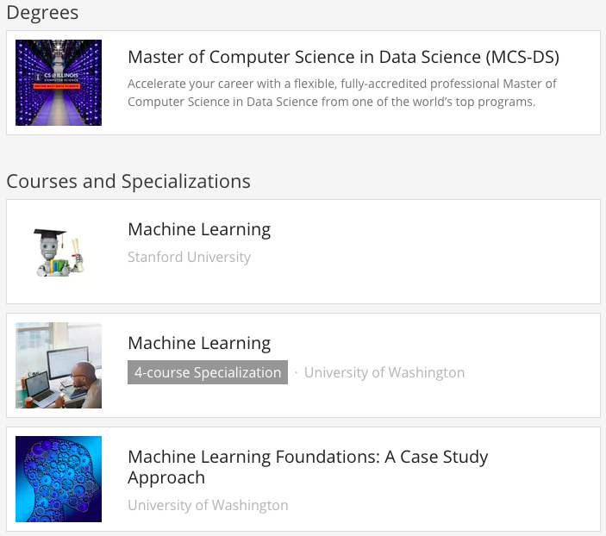
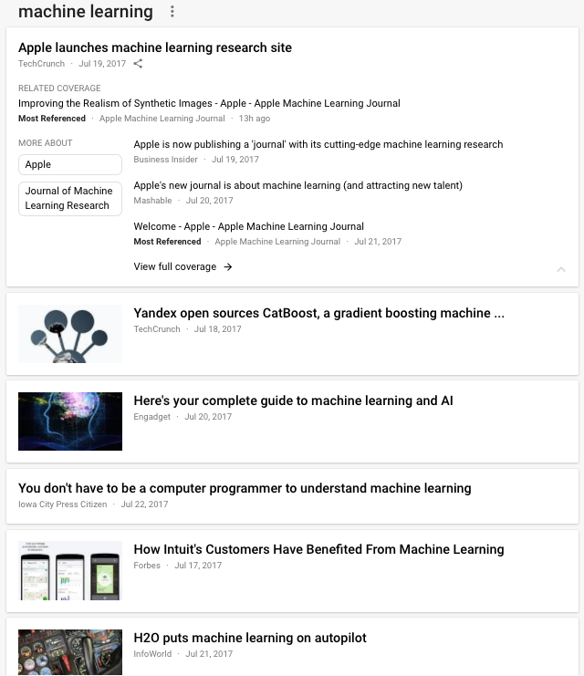
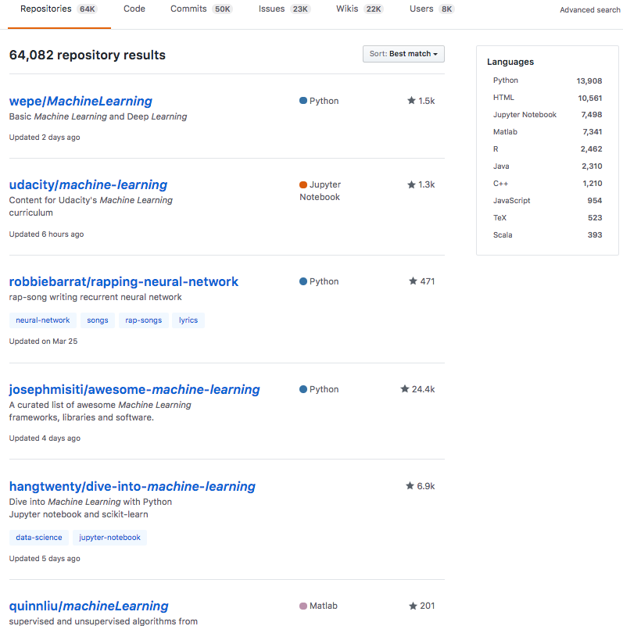
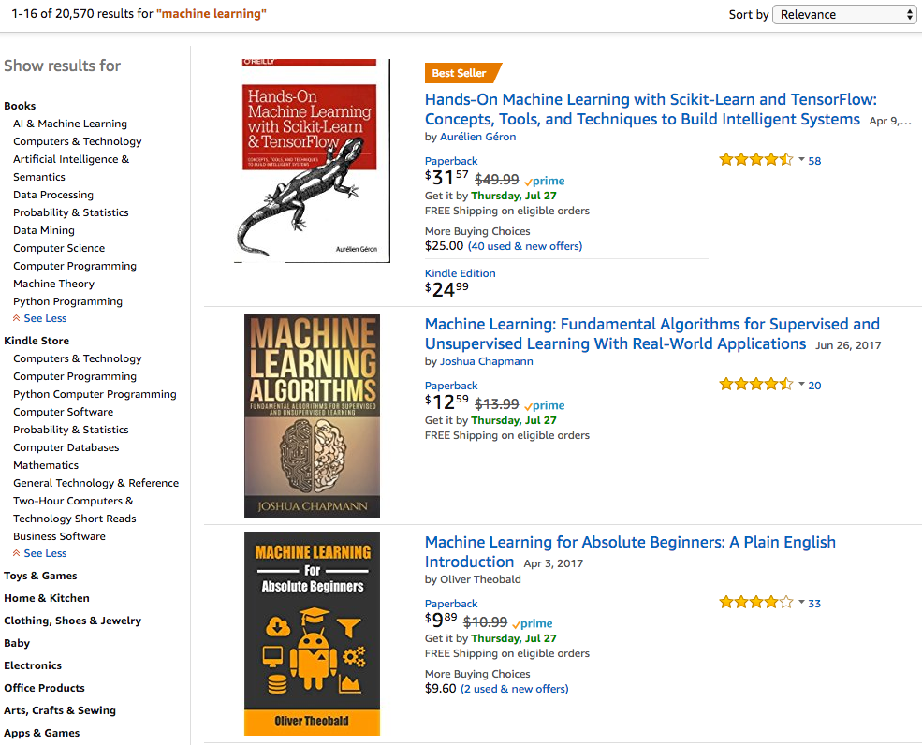
Notes:
Machine learning…
... in the news, amazon books, universities and online courses, software.

Slide 5
what is machine learning?

Slide 6
‘learning’
what do we learn?
a description of the data
a ‘model’ that tells us how the data are distributed
why?
to make predictions (or inferences / guesses) and decisions
(not only about the future)

Slide 7
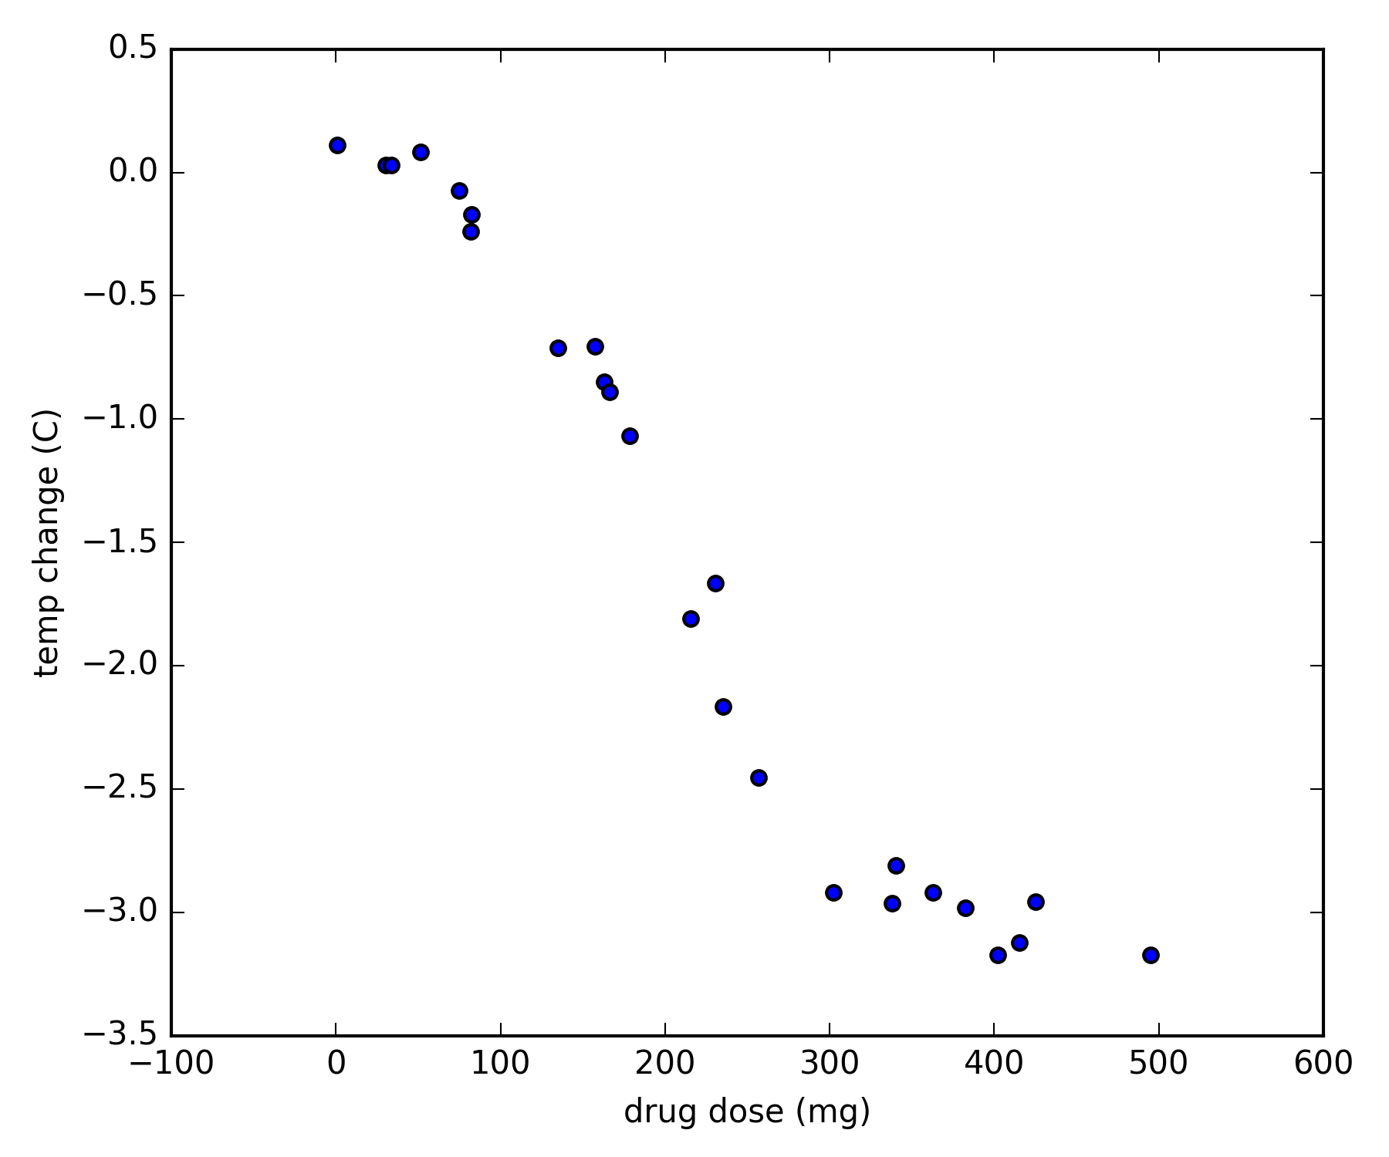
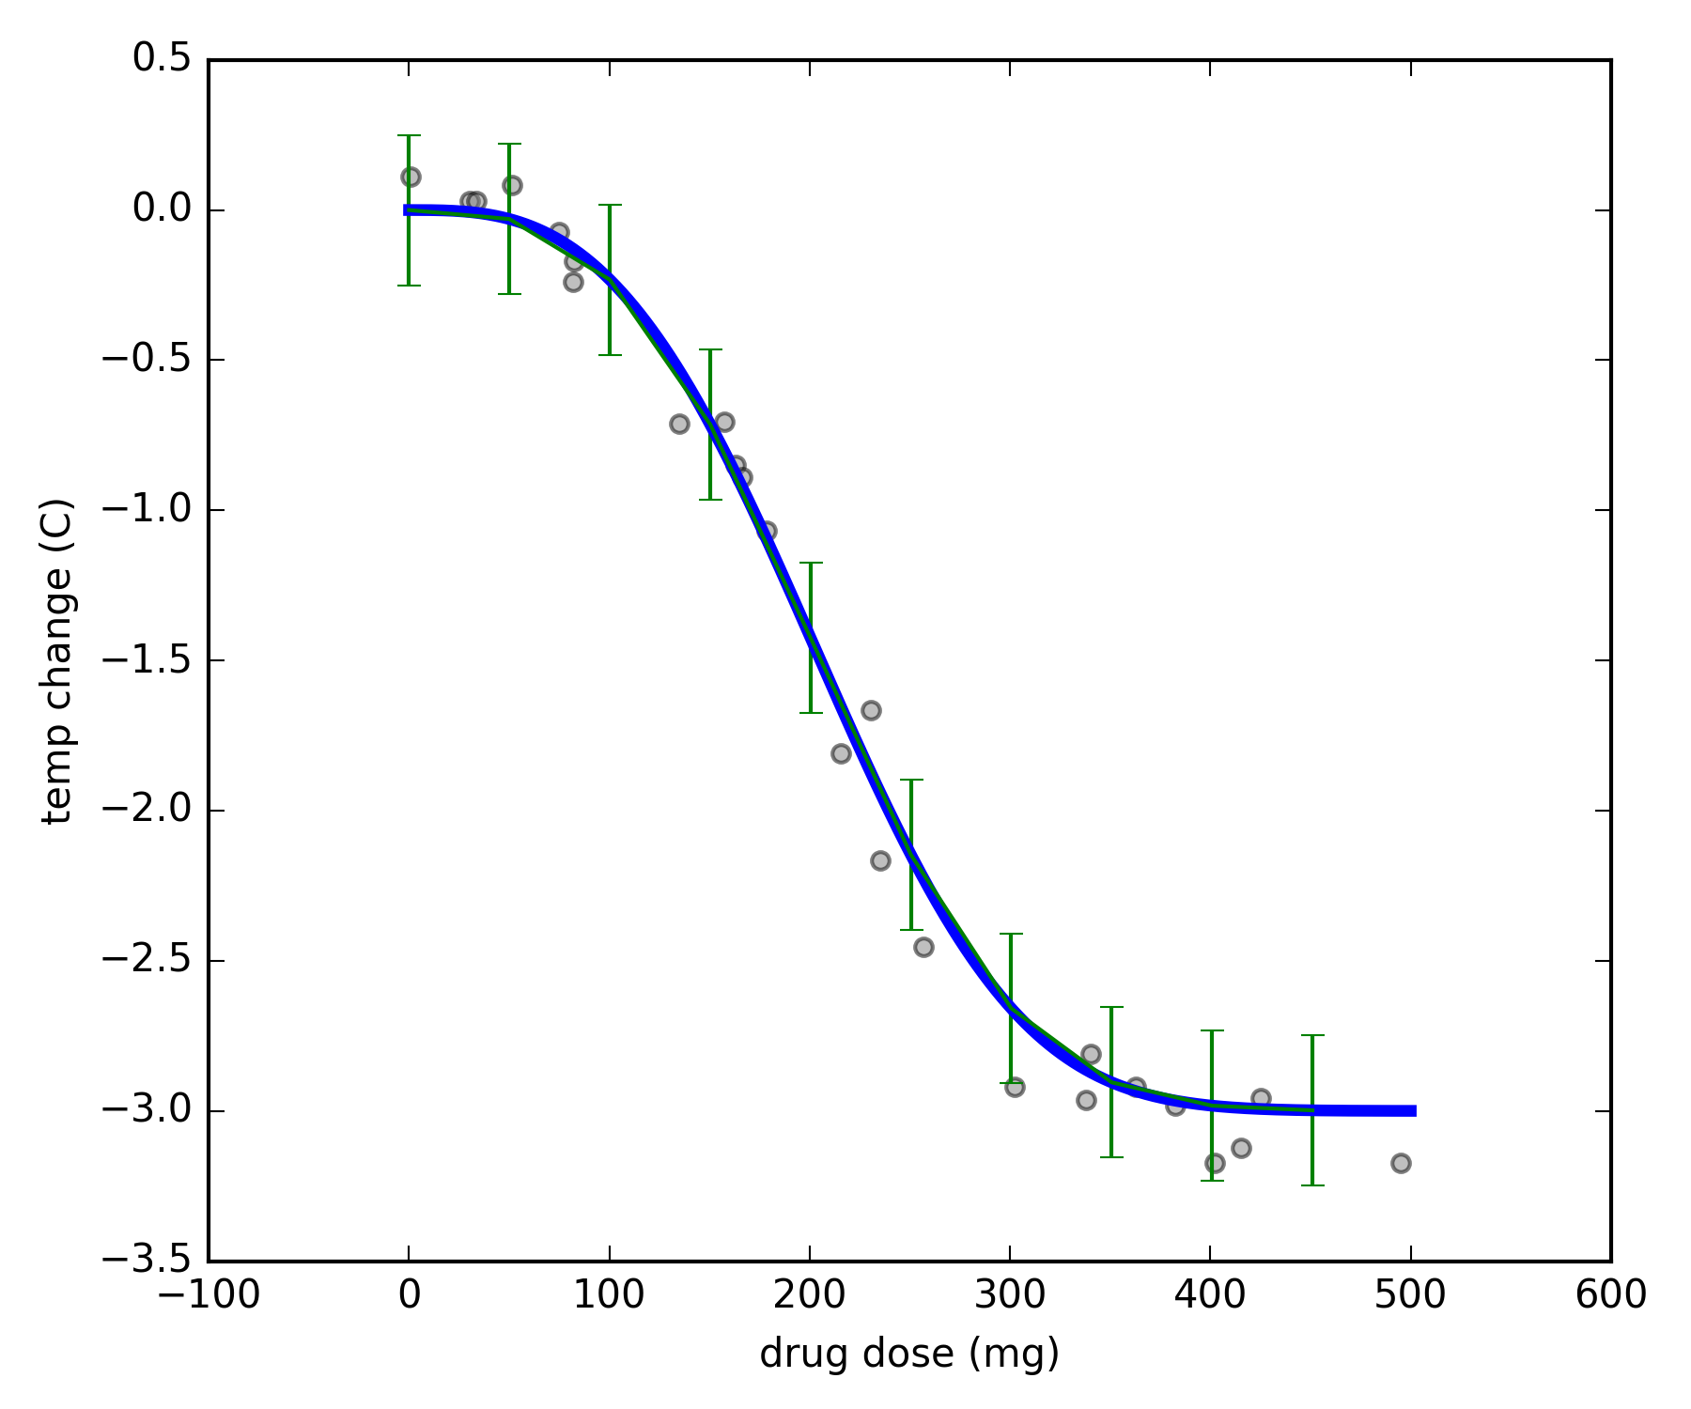
example
the patient’s temperature has just exceeded 40C
we supply the medicine and observe their temperature change after 2 hours
learning
model
data
ok, we ‘learned’ - then what?
predict what happens to temperature if we supply 200mg?
decide minimum dose to be certain to achieve at least 2C temp drop?
can do with the model
without the data

Slide 8
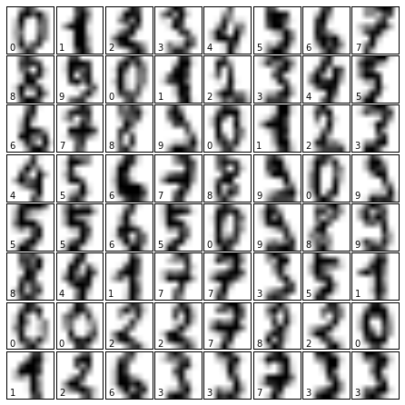
example
prediction task
digit recognition
given a handwritten digit, predict (guess) what number it represents
classification
let’s say we are given manually labeled data
how would we approach this?
how would we use a model?

Slide 9
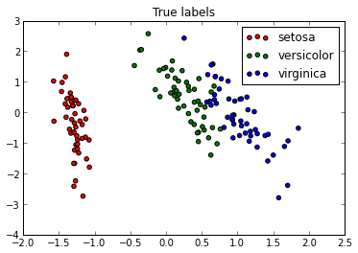
example
prediction task
what are the data?
what will the next point be?
clustering
density estimation
how would we use a model?
Y
X

Slide 10
‘machine’ learning
why do we need the machines?
to make learning
automated
and
efficient
big data
complex models

Slide 11

example: language
task: complete the sentence
language is complex
basic rules (syntax and grammar)
do not suffice for good predictions
requires complex models
data
millions/billions of sentences/queries
user features
session attributes

Slide 12
ML pipeline
learning
inference / training / fitting
data
model
prediction
decision
model candidates
probability
how much we believe that something is true
Notes:
let’s put things in order

Slide 13
outline
what is machine learning
examples of prediction tasks
data, learning, prediction, decision; probability
probability
algorithms
regression
classification
clustering
deep learning

Slide 14
probability
‘proposition’
how much we believe that something is true
GIVEN the information at hand
VERY IMPORTANT!
0: no chance 1: certain

Slide 15
probability
a ball drops out of the box
it is green
what is the probability that the proposition is true
GIVEN that
there are 100 balls,
40 of them green?
related term: ‘frequency’

Slide 16
probability
this shape is ‘1’
‘frequency’?

Slide 17
ML pipeline
learning
data
model
prediction
decision
model candidates
probability
assign probabilities to propositions

Slide 18
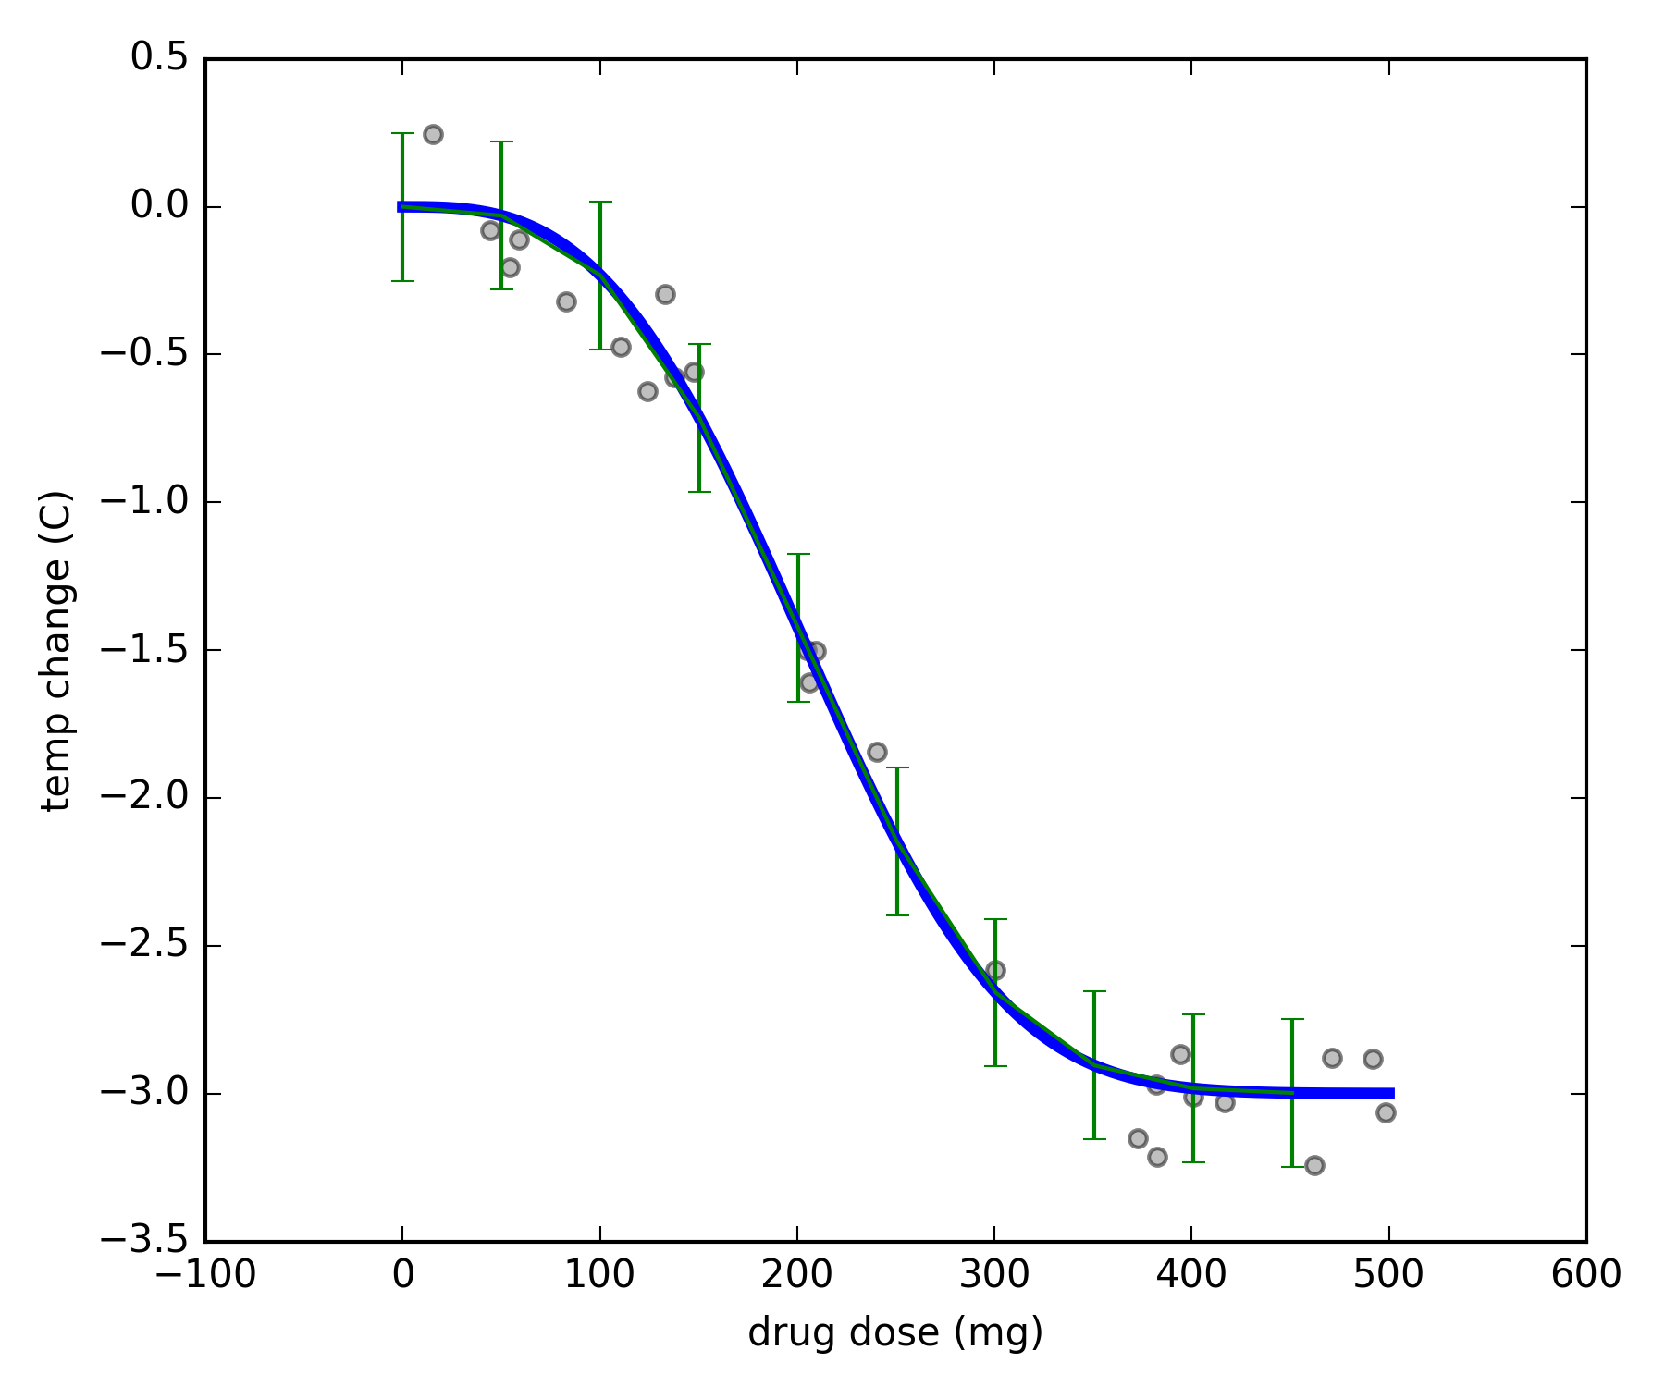
probability :: prediction
what is the probability that a dose of 300mg drops temperature more than 2C ?
probability of
temp. drop > 2C
given
dose = 300 mg and model (see figure)
proposition
p(temp. drop > 2C | dose = 300 mg ; model)
given information
the value for this probability is provided by the model!

Slide 19
ML pipeline
learning
data
model
prediction
decision
model candidates
probability
assign probabilities to models

Slide 20
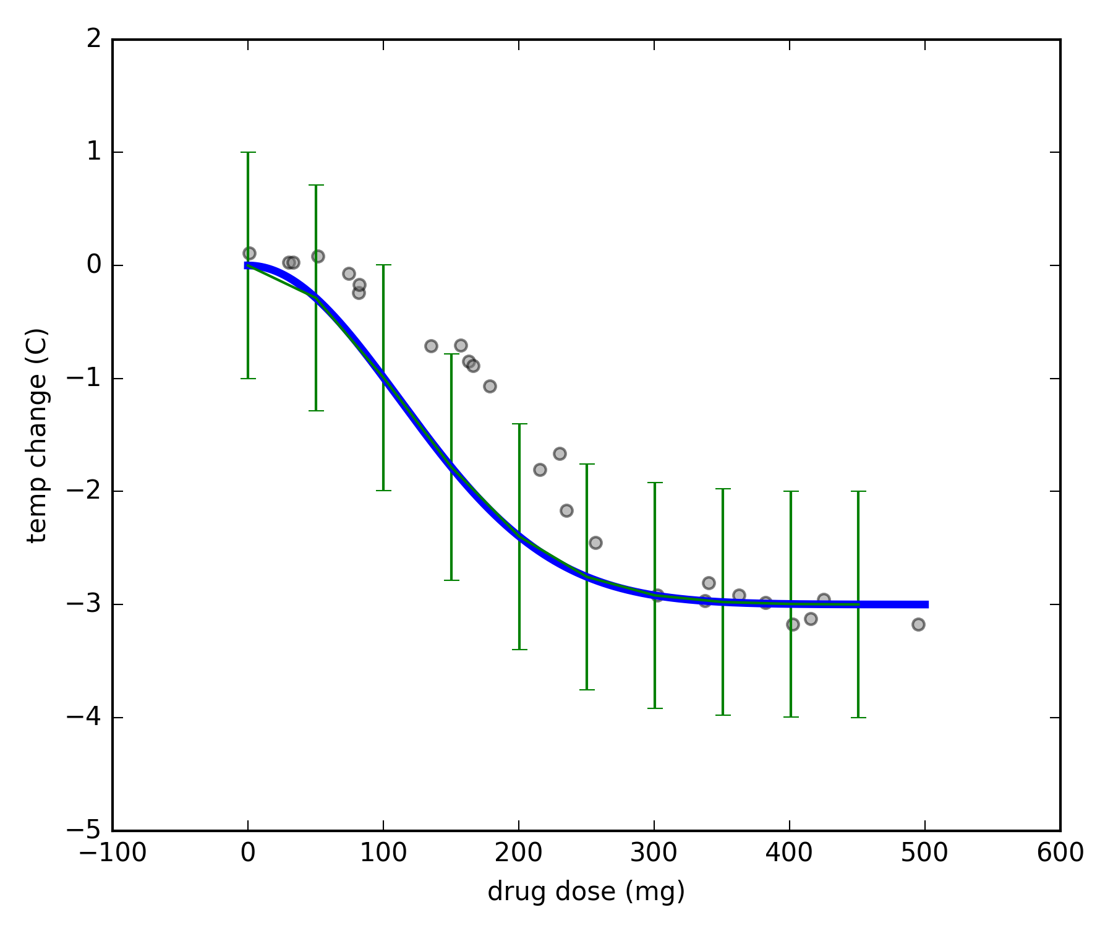
probability :: learning
consider models where temperature drops
exponentially with dose
drop : dose^{-k} and error up to ε
what is the probability that the right model is M1 / M2 / … ?
model M1
probability of
model (k, ε)
given
data
k from -5 to + 5 and ε from -2 to +2
model M2

Slide 21
probability :: learning
p( model (k, ε) | data; k in [-5, + 5], ε in [-2, +2] )
p( M | D ; I )
from Bayes’ Rule, this is proportional to
p(data | M ; I) x p(M | I)
model M1
likelihood
prior
we choose the model of maximum probability
p ( M | D ; I )
(do we have to?)
model M2

Slide 22
ML pipeline
learning
data
model
prediction
decision
model candidates
probability

Slide 23
ML pipeline – the Bayesian way
learning
data
prediction
decision
model candidates
probability
fun fact:
it took centuries to arrive at this pipeline

Slide 24
ML pipeline – in practice
3
4
2
1
learning
data
model
prediction
decision
model candidates

Slide 25
in what follows…
learning
data
model
prediction
decision
model candidates

Slide 26
outline
what is machine learning
examples of prediction tasks
data, learning, prediction, decision; probability
probability
algorithms
regression
classification
clustering
deep learning

Slide 27
regression
parts of the data
‘features’
build model that provides
dp(Y = y | X = x; Model M)
for real-valued Y
regression methods differ in the set of model candidates
they consider
each method has corresponding algorithm(s)
to search for best model
Y
X

Slide 28
some regression methods
linear regression
line + error
segmented regression
k segments + errors
multinomial regression
curve + error
this is where methods differ
p ( M | data ; I ) ∝ p(data | M ; I) x p(M | I)
each model comes with its own

Slide 29
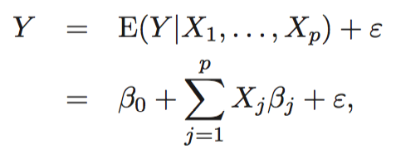
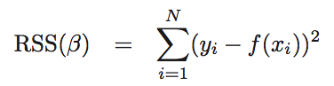
linear regression
solved with linear algebra if the data points are more than the dimensions

Slide 30
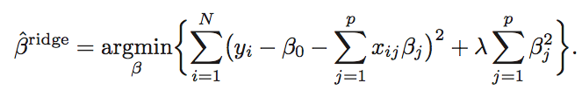
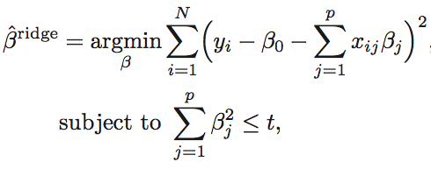
ridge regression
ridge regression

Slide 31
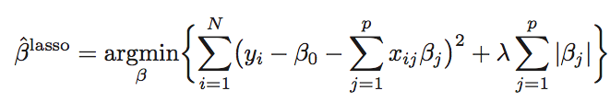
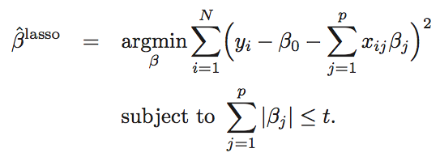
lasso

Slide 32
linear regression with shrinkage
the penalty on the volume of β expresses a prior
this is where methods differ
p ( M | data ; I ) ∝ p(data | M ; I) x p(M | I)

Slide 33
decision trees
predict the value of the leaf
build tree to minimize error
(e.g., square error)
subject to restrictions
(e.g., height of tree)
gender = male?
age > 50?
age < 25?
weight = 80
age < 25?
weight = 60
weight = 40
weight = 70
weight = 50

Slide 34
random forests
build many decision trees on
random subset of data
random subset of features
combine predictions
gender = male?
age > 50?
age < 25?
weight = 80
age < 25?
weight = 60
weight = 40
weight = 70
weight = 50

Slide 35
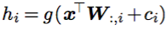
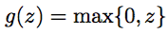
neural networks
idea
apply a linear model on a non-linear transformation of the input
relu

Slide 36
outline
what is machine learning
examples of prediction tasks
data, learning, prediction, decision; probability
probability
algorithms
regression
classification
clustering
deep learning

Slide 37
classification
build model that provides
p(Y = y | X = x; Model M)
for categorically-valued Y
classification methods differ in the set of model candidates
they consider
each method has corresponding algorithm(s)
to search for best model
what is X and Y for digit recognition?

Slide 38
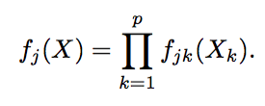
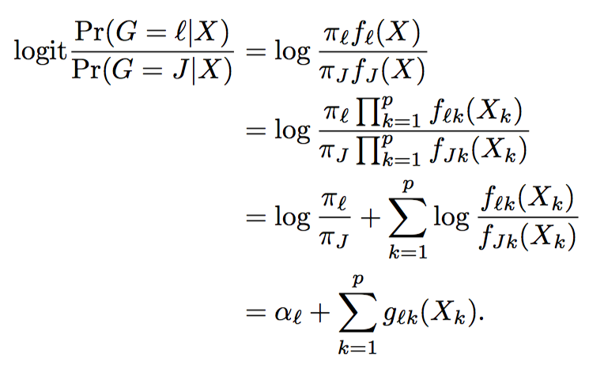
naïve-bayes
within each class, features are distributed independently
p(X | G = j) =

Slide 39
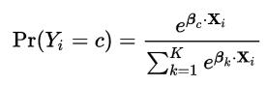
logistic regression
softmax

Slide 40
decision trees & random forests
very similar to regression methods
leafs assign probabilities to classes

Slide 41
neural networks
idea
apply a linear model on a non-linear transformation of the input
evidence for one class

Slide 42
support-vector machines
separate the classes
with hyperplanes

Slide 43
outline
what is machine learning
examples of prediction tasks
data, learning, prediction, decision; probability
probability
algorithms
regression
classification
clustering
deep learning

Slide 44
supervised and unsupervised learning
the methods we saw for
regression and classification
are cases of ‘supervised’ learning
build model that provides
p(Y = y | X = x; Model M)
other data features
some data features
build model that provides
p(X = x, Y = y; Model M)
‘unsupervised’ learning

Slide 45
unsupervised learning
build model that provides
dp(X = x, Y = y; Model M)
find structure in the data
Y
X

Slide 46
k-means clustering
model
gaussian mixture
with equal symmetric variance
clustering
(finding the clusters)
assign points to clusters
so that total distance from cluster center is minimized
k-means
assign points to cluster of nearest center
compute centers from assigned points
repeat
Y
X

Slide 47
PCA
project the data on orthogonal system
so that successive dimensions maximize remaining variance
useful for dimensionality reduction
model
gaussian distribution
on k orthogonal dimensions
equal noise on the others

Slide 48
outline
what is machine learning
examples of prediction tasks
data, learning, prediction, decision; probability
probability
algorithms
regression
classification
clustering
deep learning

Slide 49
deep learning
basically another name for ‘neural networks’
with many layers
and generalized structure
rebranded due to
efficiency and good results on difficult tasks
language
(translation, sentence completion, voice recognition)
image recognition

Slide 50
recurrent neural networks

Slide 51
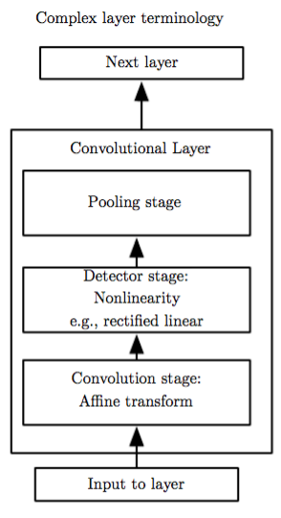
convolutional neural networks

Slide 52
convolutional neural networks

Slide 53
part 2: platforms and software

Slide 54
outline
scikit-learn
open source deep-learning libraries
cloud ML products
apache spark

Slide 55
scikit-learn
python ML library
on top of scipy stack
many general ML algorithms
standardized pipeline
ideal for fast prototyping
on moderate datasets

Slide 56
deep learning :: tensorflow
deep learning library
based on user-defined
computation graphs
for out-of-python optimization

Slide 57
deep learning :: other
torch.ch
open source machine learning library
scientific framework, programming language (Lua)
used by Facebook Research
theano
http://deeplearning.net/software/theano/
deep learning with efficient numerical operations
microsoft cognitive toolkit (cntk)
https://cntk.ai/
tensorflow alternative
keras
simpler tensorflow, theano, cntk in python

Slide 58

cloud :: google
Cloud ML Engine
basically offers the ML pipeline
with Deep Learning models
implemented in Tensorflow
other services
trained models for other applications
speech, video or image tagging, translation
https://cloud.google.com/products/machine-learning/
pricing: about 0.5$ per hour
Notes:
https://cloud.google.com/ml-engine/
https://research.googleblog.com/2016/06/wide-deep-learning-better-together-with.html
https://cloud.google.com/speech/

Slide 59

cloud :: other
amazon aws
classification and regression
with logistic and linear regression
microsoft azure
‘cortana intelligence’
ML pipeline
Notes:
http://docs.aws.amazon.com/machine-learning/latest/dg/types-of-ml-models.html

Slide 60

apache spark
machine learning algorithms
on top of Spark
iterative optimization

Slide 61
part 3: hands-on session

Slide 62
outline
scikit-learn
tensorflow

Slide 63
scikit-learn
http://scikit-learn.org/

Slide 64
tensorflow
https://www.tensorflow.org/

Slide 65
the end…

Slide 66
ML pipeline
learning
data
model
prediction
decision
model candidates
probability

